Slide 1
Common Health Problems In
It Professionals

Slide 2
What’s we going to discuss
Various Health Problems faced by IT Professionals.
And how can we Prevent them

Slide 3
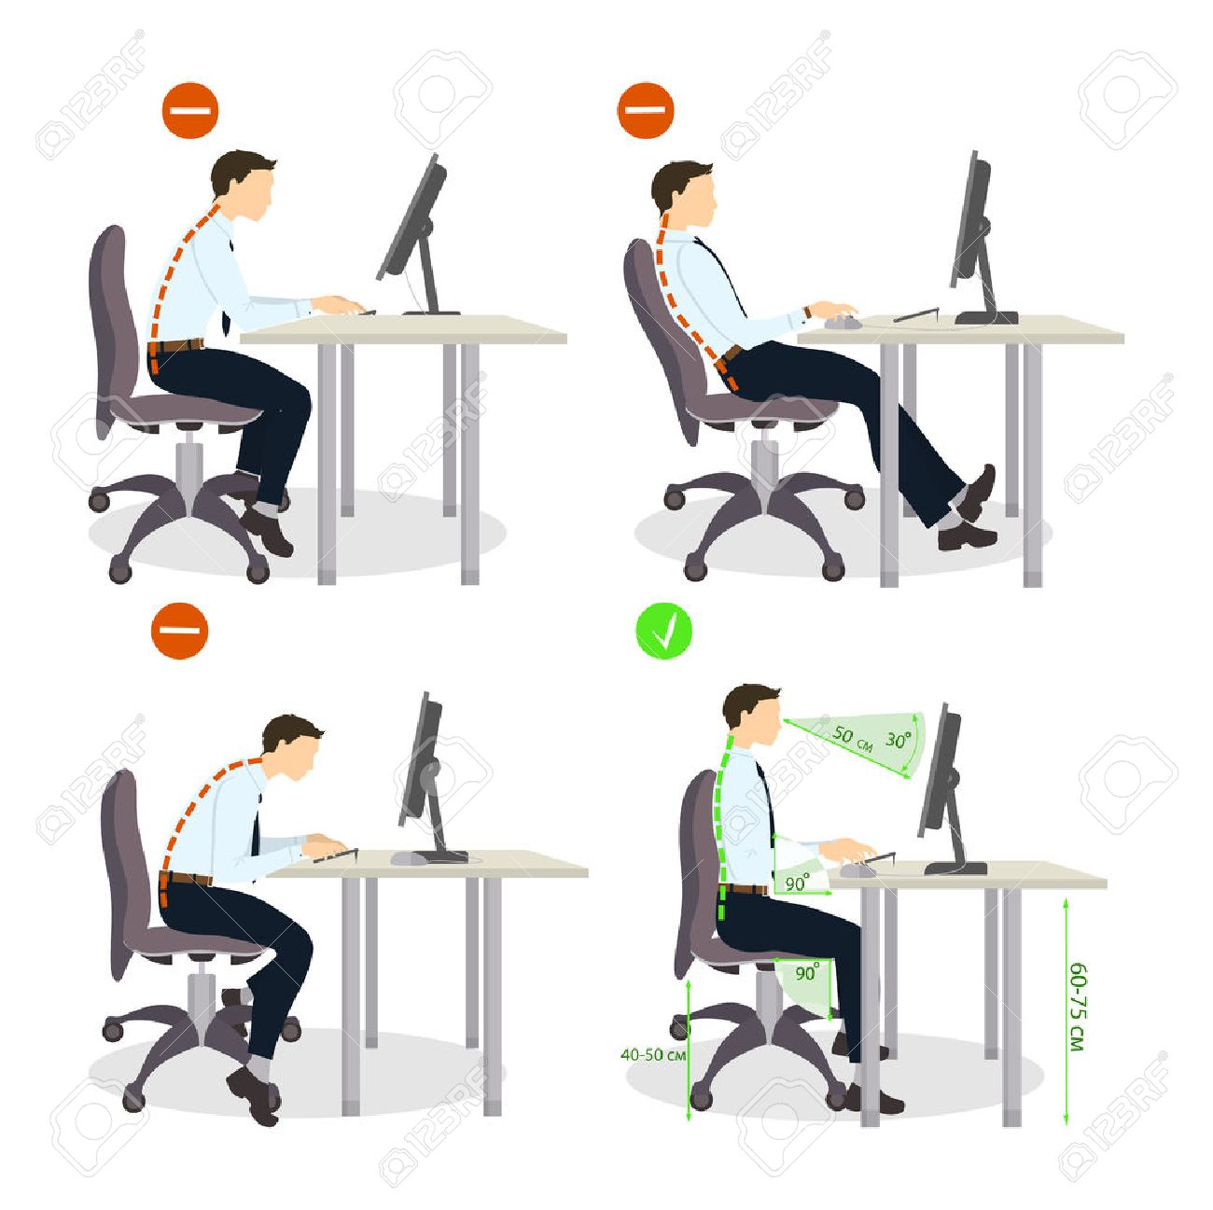
Lower Back Pain
Most Common Problem found in IT Professionals
Almost 80% of people who spend more than 8 hours in front of a computer which can lead to great stress on bony joints and cartilages of back leading to back pain.

Slide 4
Carpal Tunnel Syndrome
Symptoms
Numbness and tingling of the hand and fingers
Pain is worse at night & person may have sleepless nights.
As disease advances—Burning sensation, weakness of hand.
Decreased grip strength leading to frequent dropping of objects from the hand.
Occasionally, sharp shooting pains can be felt in the forearm.

Slide 5
Prevention
Frequent stretches and bending of wrists
Keep your keyboard at a height where the elbow is at 90 degrees to the table
Using gel pads to support the base of your palm
Don’t sit and type for hours,. take short breaks in between

Slide 6
Anxiety And Stress
Targets and deadlines!

Slide 7
Prevention
Don’t carry your work to home, limit your work to work place only
Take a hobby, Spend time with family
Do Exercise or Sports’
Yoga and Relaxation Therapies

Slide 8
Heart Disease
Sitting Longer Periods of time leads various health problems such as Obesity and metabolic syndrome which has cluster of Conditions such as,
increased blood pressure
high blood sugar
Excess body fat around waist
Abnormal Cholesterol levels

Slide 9
Prevention
Avoid sitting for long hours
Involve in a exercise program

Slide 10
Insomnia
Insomnia is the difficulty in sleeping not the REST client
16% of people who work late has a chance of getting insomnia
alter the release of the sleep chemical melatonin.

Slide 11
Prevention
Try to get at least 6 hours of sleep
Switch off TV and mobile phone once you hit the bed
Use dim lights in bed room

Slide 12
Conclusion
Most of these health problems are easily preventable by adopting to Best health practices and following a Exercise routing.

Slide 13
Thank YOU

